Slide 1
Stock Price Prediction
Notes:
<number>

Slide 2
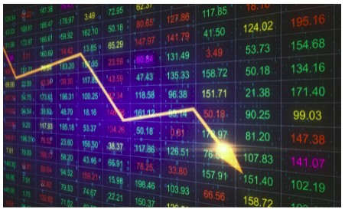
What is the Stock Market?
A stock market is a public market
where you can buy and sell shares
for publicly listed companies.
The stocks, also known as equities,
represent ownership in the company.
The stock exchange is the mediator
that allows the buying and selling of
shares.
1

Slide 3

Introduction to Stock Price Prediction
Stock price prediction is the process of forecasting future stock prices based on historical data and market trends.
It is a crucial aspect of investment decision-making and is used by investors to make informed buying or selling decisions.
Various methods and techniques are employed to analyze data and make accurate predictions.
2
Notes:
Image source: https://hackr.io/blog/machine-learning-projects
<number>

Slide 4
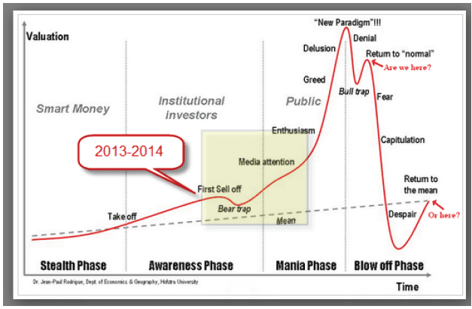
Importance of Stock Price Prediction
Accurate stock price prediction helps investors minimize risks and maximize returns on investments.
It provides valuable insights into market trends, allowing investors to make timely decisions.
Stock price prediction plays a vital role in portfolio optimization and asset allocation strategies.
3
Notes:
Image source: https://mystocksinvesting.com/guest-post/learn-how-to-increase-your-profits-in-2014/
<number>

Slide 5
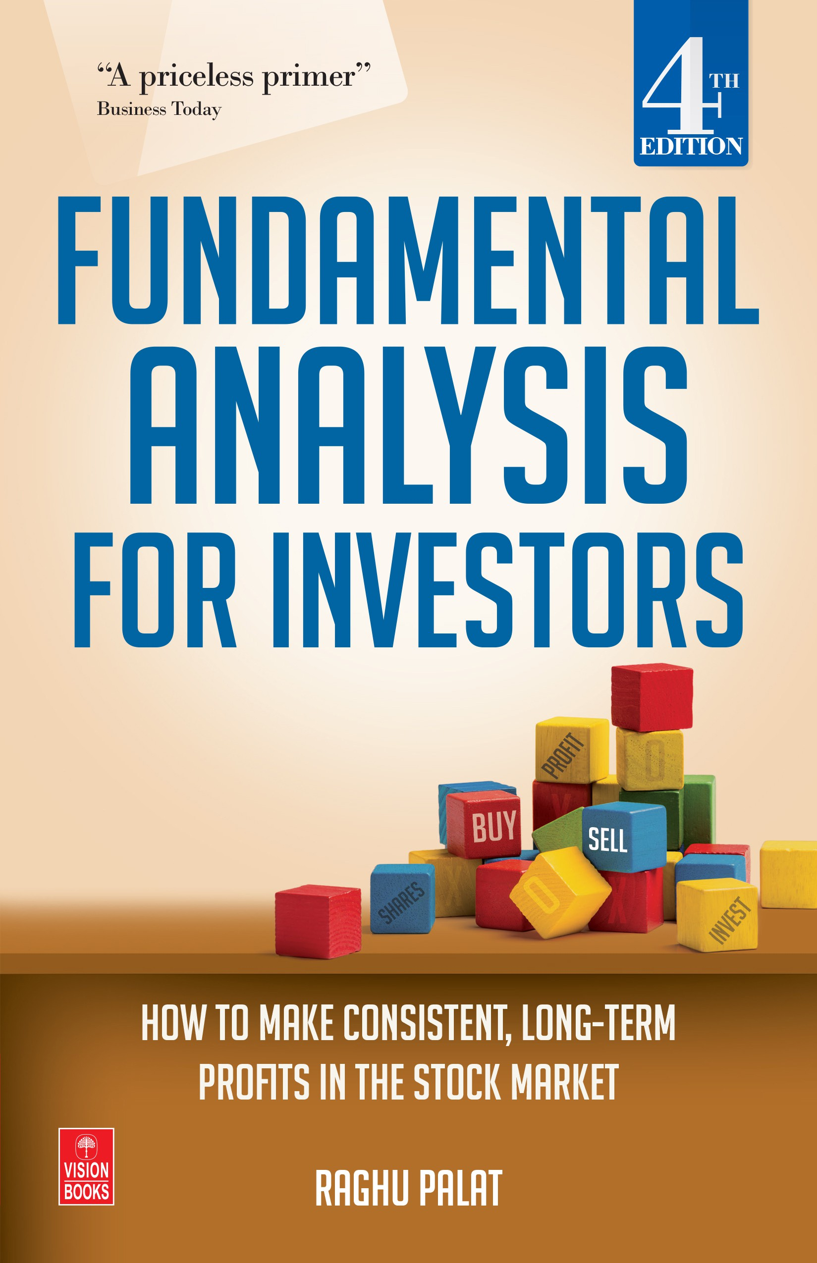
Fundamental Analysis for Stock Price Prediction
Fundamental analysis involves evaluating a company's financial health, market position, and future prospects.
Key factors considered in fundamental analysis include revenue, earnings, debt, management, industry outlook, and competitive landscape.
By analyzing these factors, investors can estimate the intrinsic value of a stock and predict its future price trajectory.
4
Notes:
Image source: https://stockanalysisbutsugan.blogspot.com/2015/05/stock-fundamental-analysis.html
<number>

Slide 6
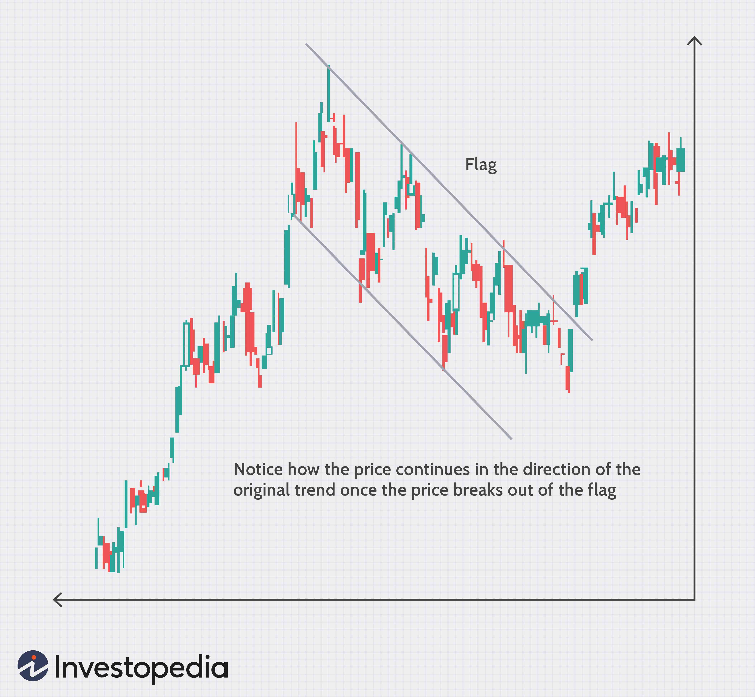
Technical Analysis for Stock Price Prediction
Technical analysis involves studying historical price patterns, trading volume, and market indicators to predict future stock prices.
Key tools used in technical analysis include moving averages, trend lines, support and resistance levels, and chart patterns.
Technical analysts believe that past price and volume patterns can help identify future price trends and market behavior.
5
Notes:
Image source: https://www.investopedia.com/articles/technical/112601.asp
<number>

Slide 7
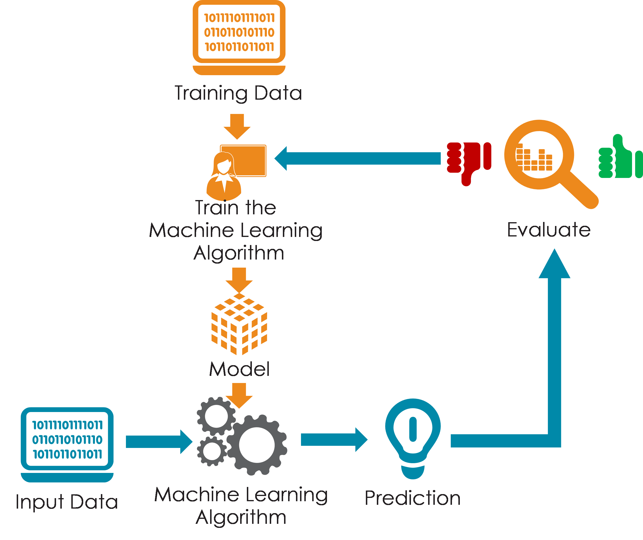
Machine Learning for Stock Price Prediction
Machine learning algorithms and models are increasingly being used for stock price prediction.
These algorithms analyze vast amounts of historical data, market news, and other relevant information to make predictions.
Machine learning models can identify complex patterns and relationships in data, enabling more accurate stock price predictions.
6
Notes:
Image source: https://www.riset.guru.pubiway.com/machine-learning-process/
<number>

Slide 8
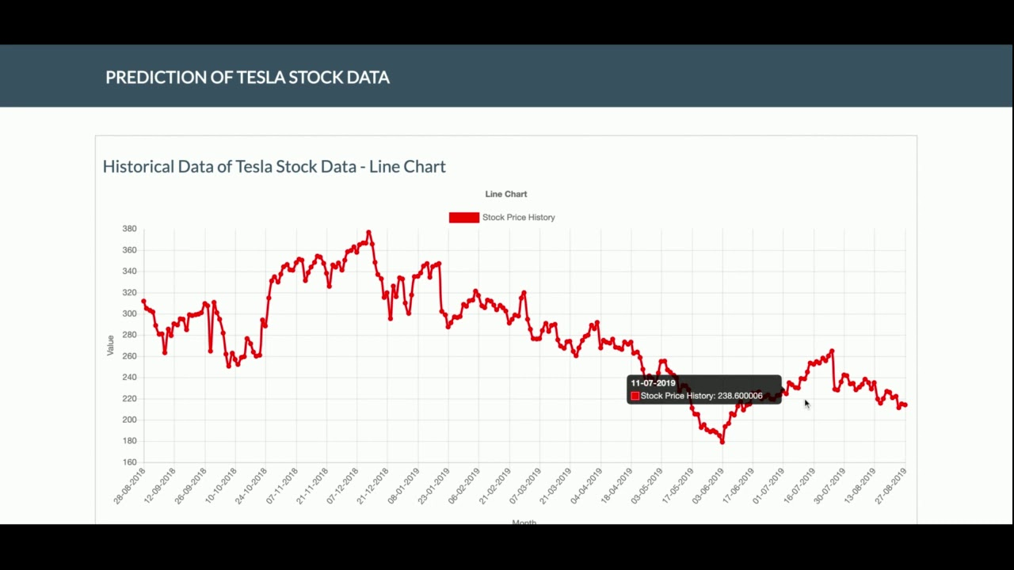
Challenges in Stock Price Prediction
Stock price prediction is inherently complex and subject to various challenges, including market volatility and unpredictable events.
Over-reliance on historical data and assumptions can lead to inaccurate predictions.
The efficient market hypothesis suggests that stock prices reflect all available information, making prediction challenging.
7
Notes:
Image source: https://lupon.gov.ph/deep-learning-stock-prediction-c-g5gm9eid
<number>

Slide 9
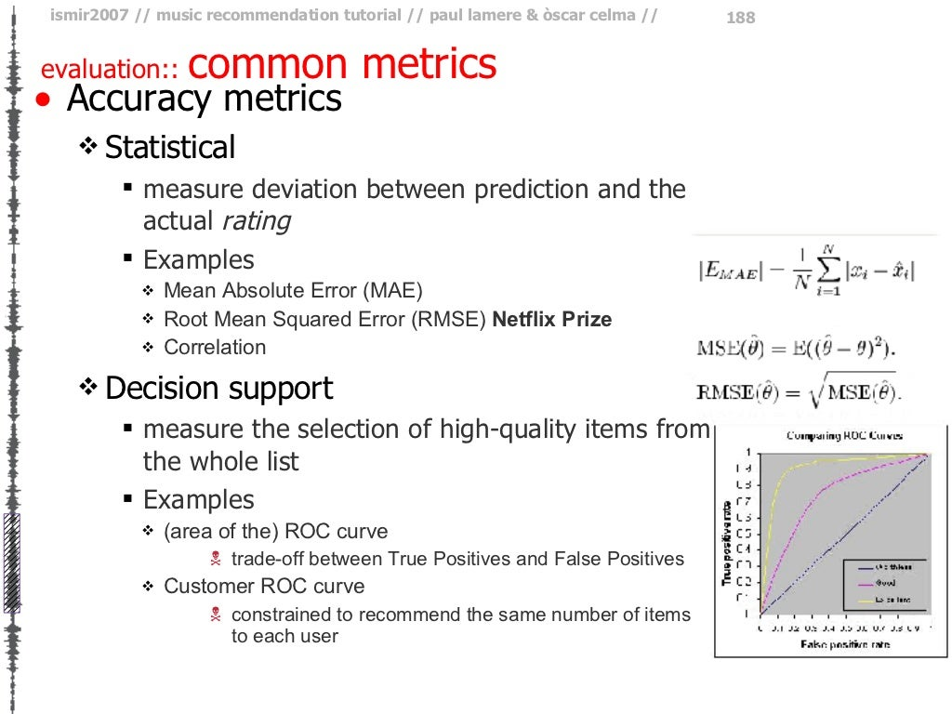
Evaluation Metrics for Stock Price Prediction
Various evaluation metrics are used to assess the accuracy and performance of stock price prediction models.
Common metrics include mean squared error (MSE), root mean squared error (RMSE), mean absolute error (MAE), and R-squared.
These metrics help investors understand the reliability and effectiveness of different prediction models.
8
Notes:
Image source: https://www.slideshare.net/ocelma/music-recommendation-tutorial/188-evaluation_common_metrics_ulliAccuracy_metrics
<number>

Slide 10
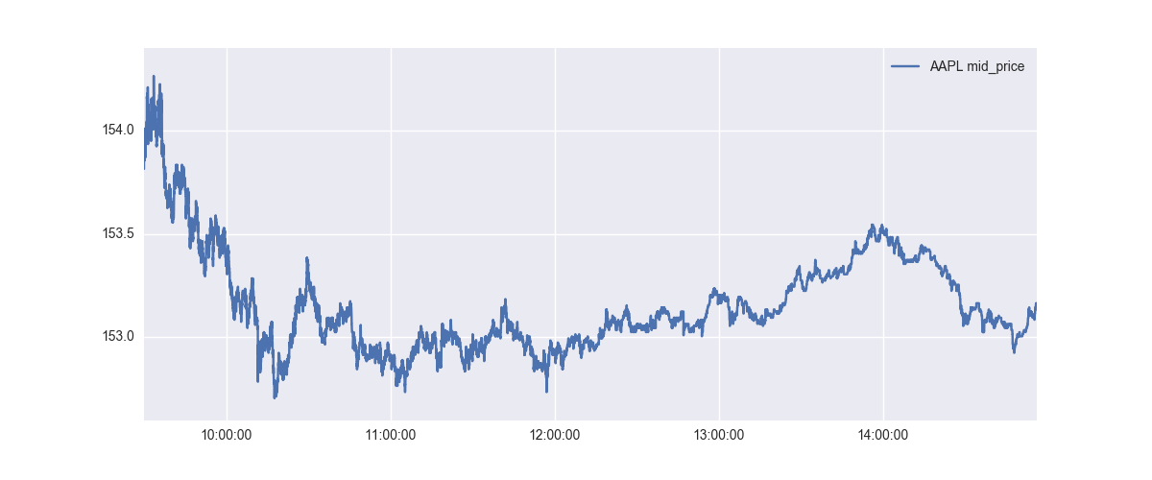
Popular Stock Price Prediction Models
Popular stock price prediction models include autoregressive integrated moving average (ARIMA), long short-term memory (LSTM), and random forest.
ARIMA models are commonly used for time series analysis and predicting future stock prices based on past trends.
LSTM models are deep learning algorithms that can capture long-term dependencies and are effective for sequential data prediction.
9
Notes:
Image source: https://www.hardikp.com/2017/10/03/intraday-stock-price-prediction-1/
<number>

Slide 11
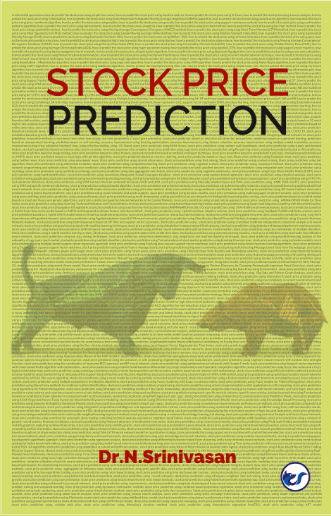
Limitations and Risks in Stock Price Prediction
Despite technological advancements, stock price prediction remains inherently uncertain and carries risks.
Market conditions, unforeseen events, and human biases can impact the accuracy of predictions.
Investors should be cautious and use stock price predictions as one of the many factors in their investment decision-making process.
10
Notes:
Image source: https://www.cleverfoxpublishing.com/product/stock-price-prediction-a-referential-approach-on-how-to-predict-the-stock-price-using-simple-time-series/
<number>

Slide 12
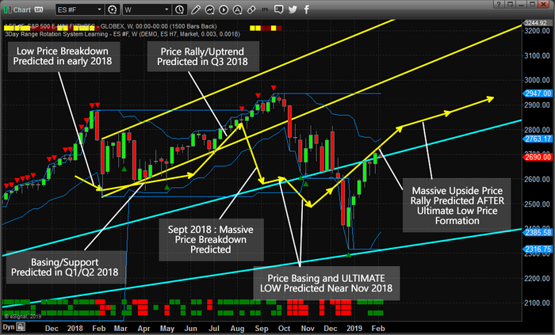
Conclusion
Stock price prediction is a valuable tool for investors to make informed decisions and maximize returns.
It involves analyzing historical data, market trends, and using various techniques such as fundamental analysis, technical analysis, and machine learning.
While stock price prediction has its limitations and risks, it provides valuable insights to investors in the dynamic world of stock markets.
11
Notes:
Image source: https://ubicaciondepersonas.cdmx.gob.mx/stock-market-prediction-ee-15364028
<number>

Slide 13
Thank You
12

